Slide 1
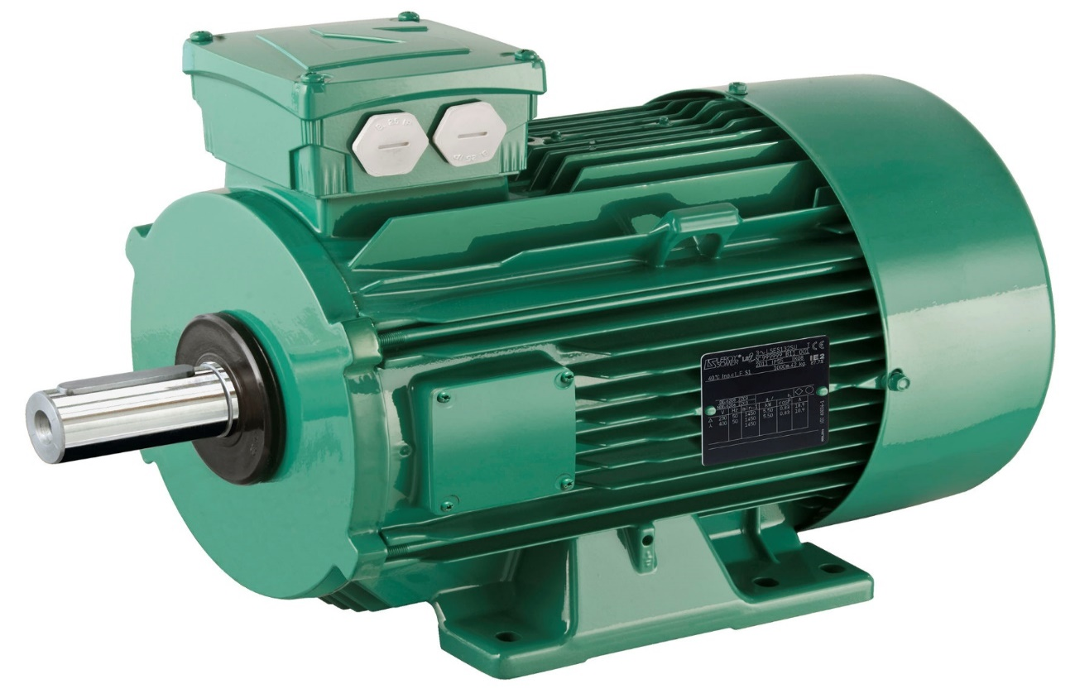
Electric Motors
Written By Sarthak Nadkarni

Slide 2
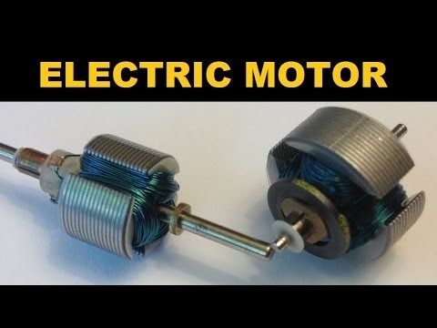

Slide 3
What Is An Electric Motor ?
Converts electrical energy into mechanical energy
They are powered from batteries
Produce Linear or Rotary Force
They operate between motor’s magnetic field
Are classified as power source type
Can be distinguished from magnetic solenoids

Slide 4
Why would someone use this product?
It is a low cost
It has an excellent speed control
A great efficiency in operation

Slide 5
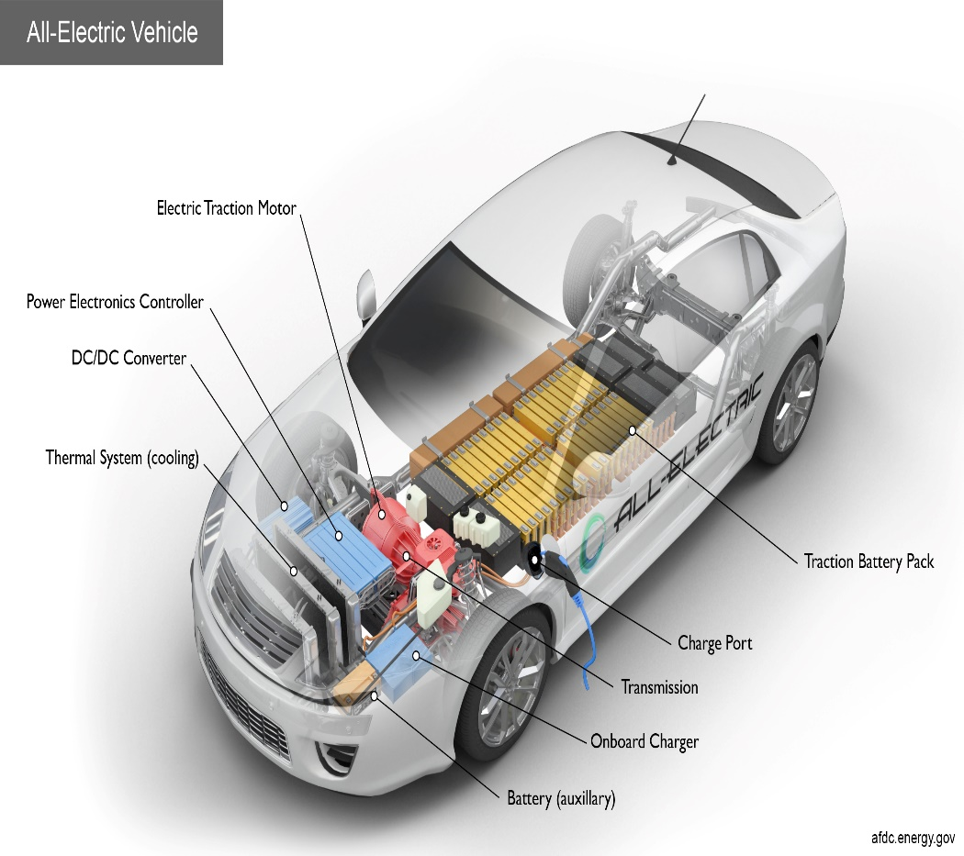
How are electric motors useful in society?
use it for cars trucks, etc
Use it for household appliances
Use it for electrical appliances

Slide 6
Questions
What principal does electric motor work?
Motor Principal

Slide 7
Questions:
2. How many types of electrical motors are there? Name them. What does it stand for?
Two Motors: AC ( Alternating
Current) and DC ( Direct Current)
Electrical Motors

